Slide 1
R Leaflet
Topics
Mapping assignment: Q&A
Color & design: considerations
Map projections: brief overview
Geocoding: ggmap
Leaflet: interactive, zoomable maps
MUSA 620: Week 10

Slide 2
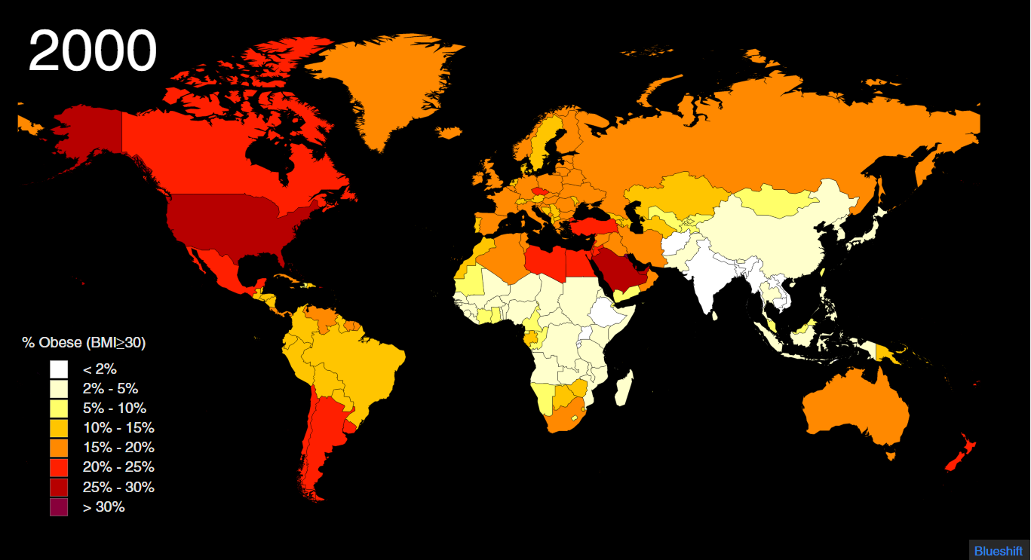
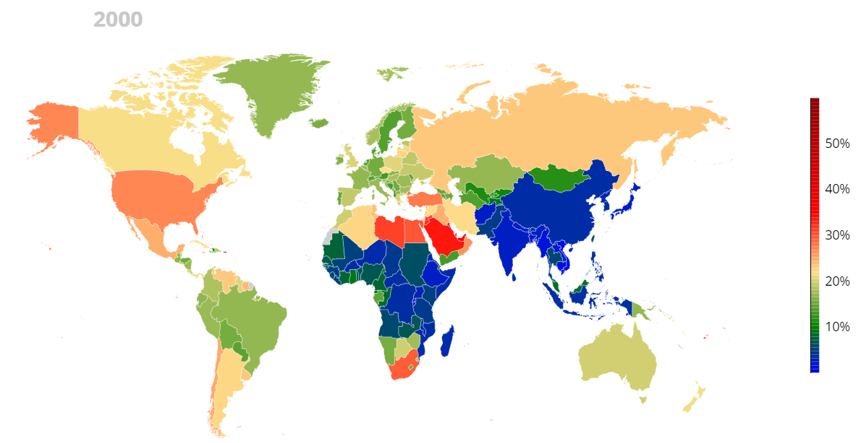
Color & Design
These maps show the same data, but tell a very different story. What design elements account for the difference?
http://metrocosm.com/map-world-obesity/
http://www.ncdrisc.org/obesity-prevalence-map.html

Slide 3
Color & Design Considerations
Color scale Color palette Legend Map projection Animation speed

Slide 4
Color & Design Considerations
Discrete Sequential -- clear hierarchy Labeled, prominent colors Familiar -- Miller projection Just slow enough to follow
Color scale Color palette Legend Map projection Animation speed
Continuous -- necessary to go up to 60%? Categorical -- which colors are high/low? No label, takes concentration to read Why is the northern US border curved? Fast
Important color-related questions to consider:
What is the right number of color thresholds?
How far apart should they be?
What color palette to choose?

Slide 5
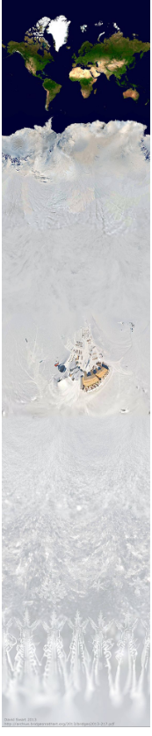
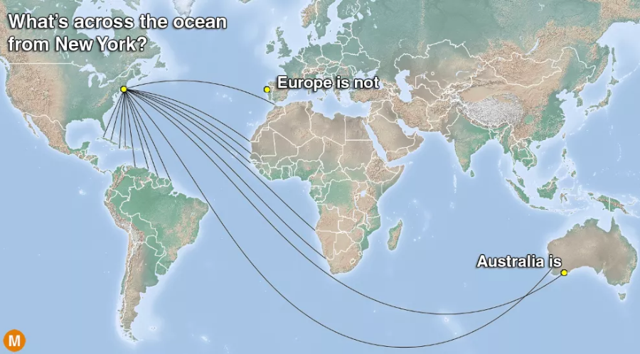
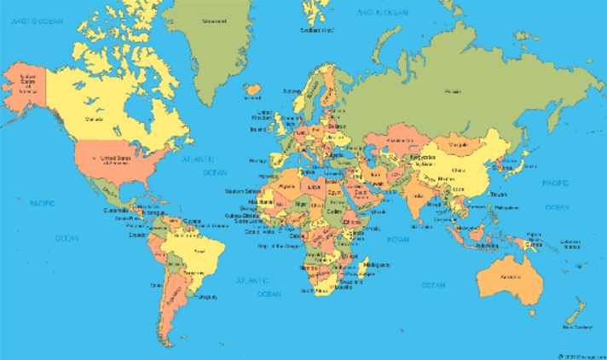
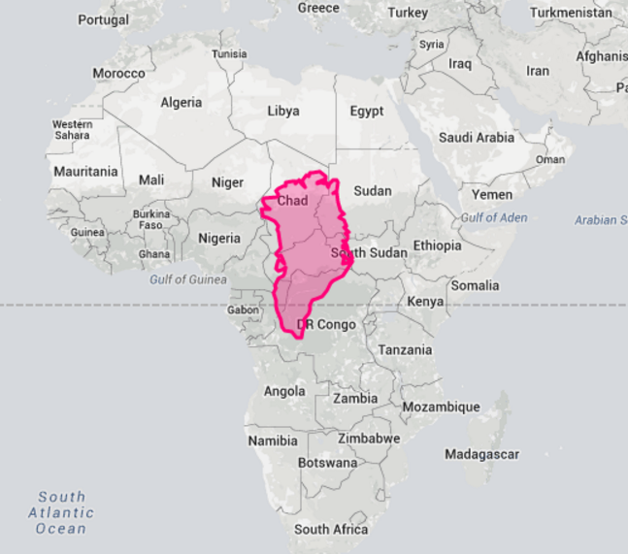
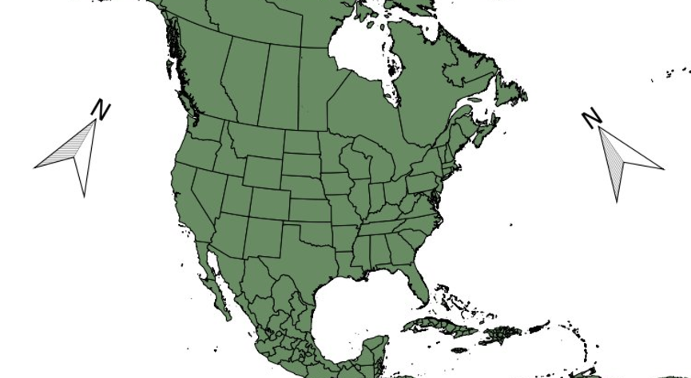
Map Projections: the World is Weird
All of these lines are straight
Mercator Uncropped
Both of these arrows point north
Greenland is not the same size as Africa

Slide 6
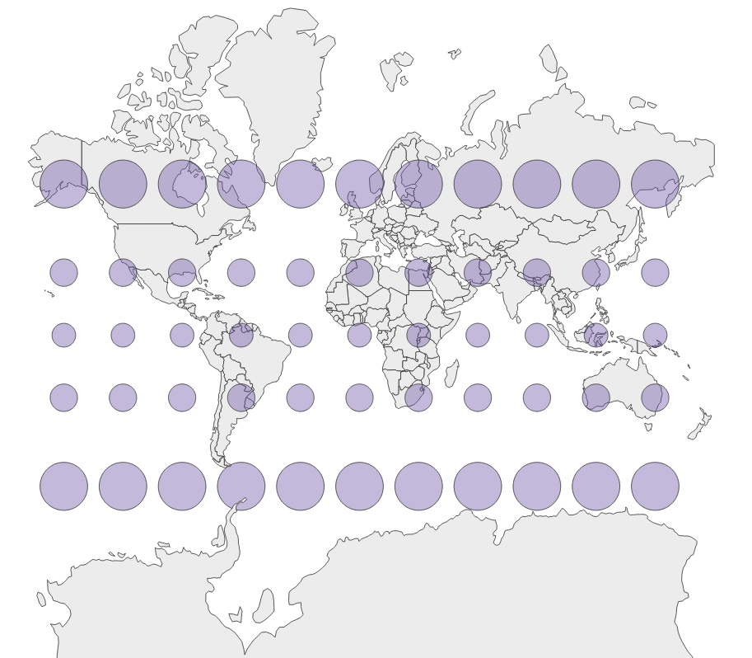
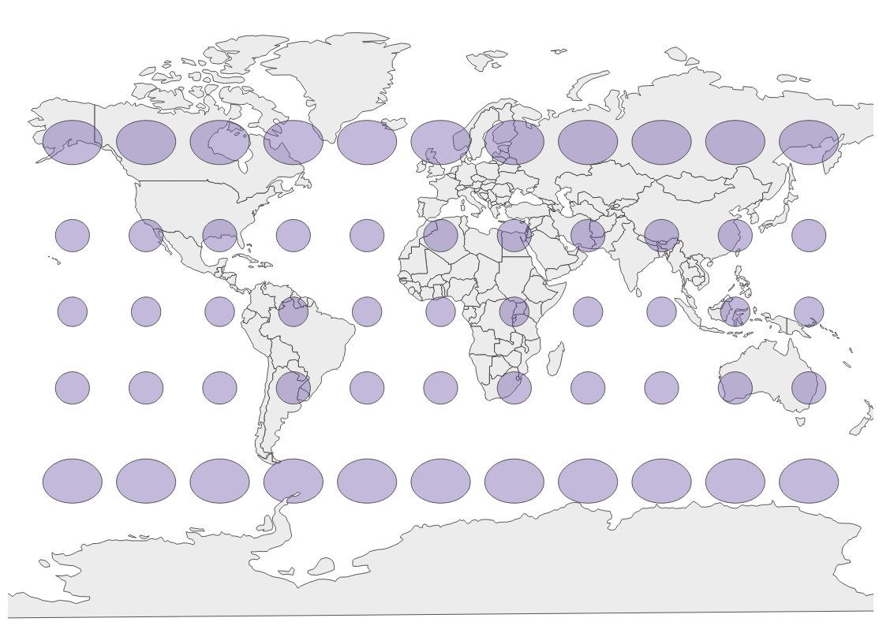
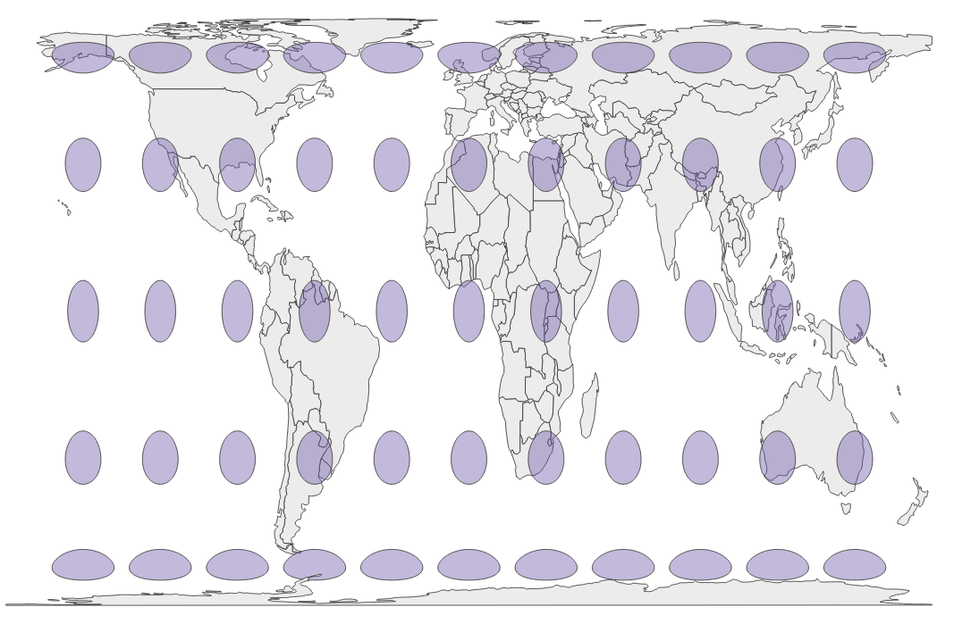
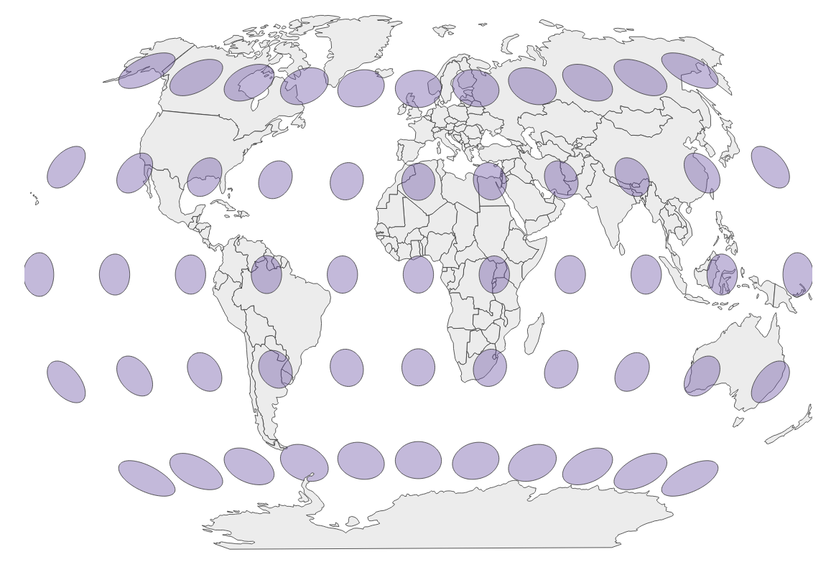
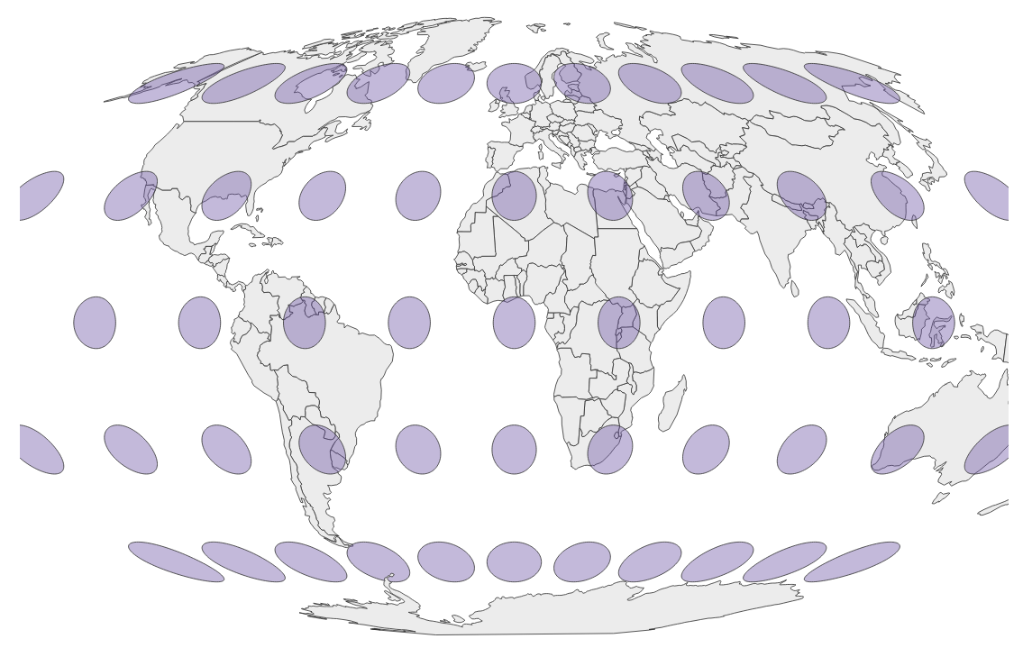
Map Projections
No 2D map can accurately portray the Earth’s 3D surface. Every map projections offers a different tradeoff, less accuracy in certain areas for more accuracy in others. Compare these map projections online.
Mercator: accurate with shapes and angles, inaccurate with size. Whenever possible, avoid it!
Gall-Peters*: accurate with size & angles, inaccurate with shapes. Unfamiliar. Just my opinion: avoid it!
Miller: retains the familiarity of Mercator without the extreme distortions.
Winkel-Tripel*: generally considered the most balanced map projection. Used by National Geographic.
Mollweide*: also very balanced. Some prefer it over Winkel-Tripel for its elliptical shape.
* Equal area projection

Slide 7
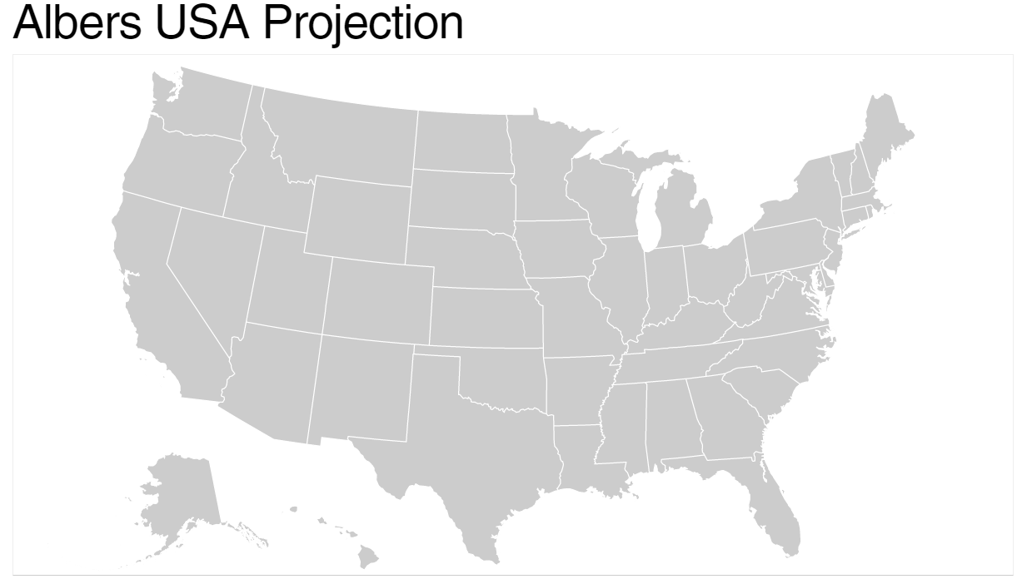
Map Projections: Albers for US Maps
In addition to the Miller, Winkel-Tripel, and Mollweide projections, the Albers projection, for US maps, is another good one to know. It is the likely the US map you’re most familiar with, and like Winkel-Tripel and Mollweide, it is an equal area projection.
The composite Albers USA projection, with Alaska and Hawaii tucked in underneath

Slide 8
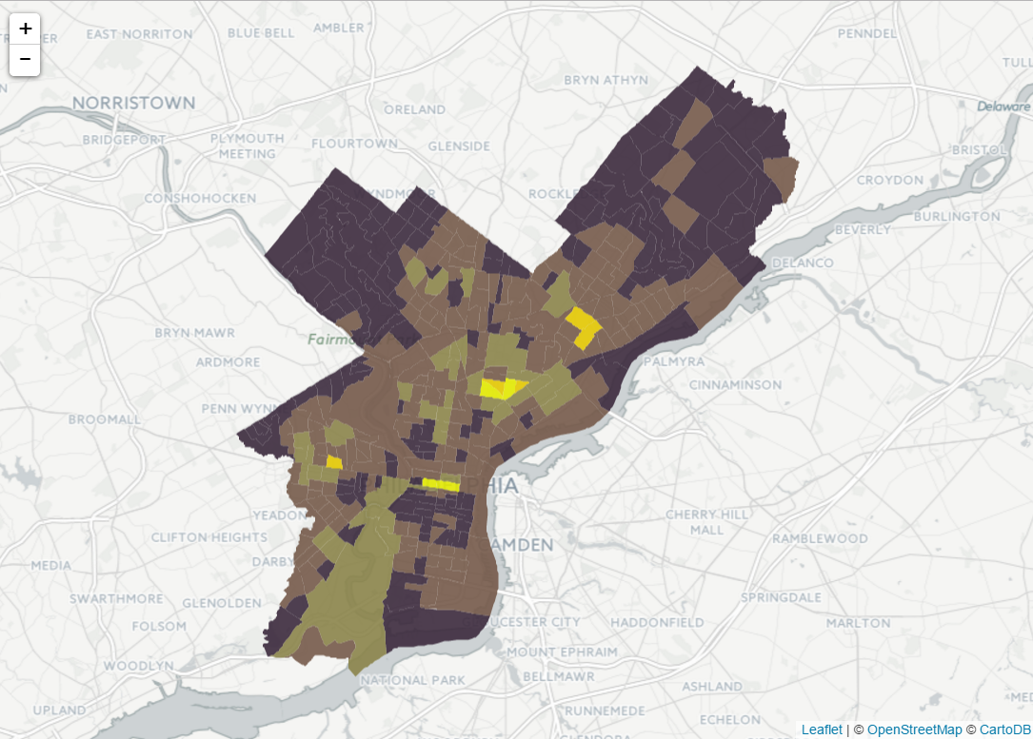
R Leaflet
Leaflet is a popular mapping package for JavaScript. It provides the framework for building fully zoomable, interactive maps.
R Leaflet provides the JavaScript bindings for creating Leaflet maps in R – to be exported to the web.
Philadelphia Crime, 2016
https://blueshift.io/philly-crime.html

Slide 9
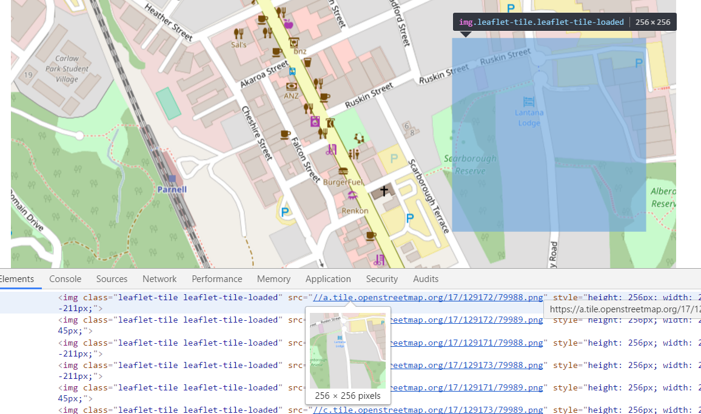
R Leaflet: Map Tiles
Map tiles: Square-shaped images files that are loaded dynamically and stitched together to form the base map. They are reloaded each time the map is panned or zoomed.
https://b.tile.openstreetmap.org/17/129170/79988.png

